Slide 1


ECEN 404 Final Presentation Team 48: Pocket Diagnostics Team Members: Rohan Bharadwaj, Donavan Burrow, Jacob Newlin, Elijah Rodriguez TA name: Zian Wang Sponsor: Dr. John Lusher

Slide 2
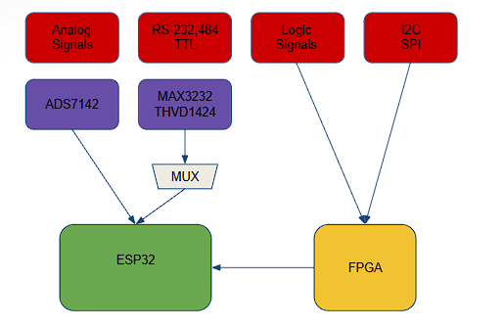
Problem Overview
Problem statement:
Technicians in the electronics industry have evolved to servicing customers directly for consumer products, similarly to a plumber or electrician. Often they cannot bring or access bench devices and a suitable substitute is required to complete a job in a timely manner.
Function of the Pocket Diagnostics:
Provide a simple, man portable bench device that can evaluate low frequency electrical signals, I2C data signals, SPI data signals, Serial data signals and 16 channel logic signals for troubleshooting on devices that contain such data transfer methods.

Slide 3
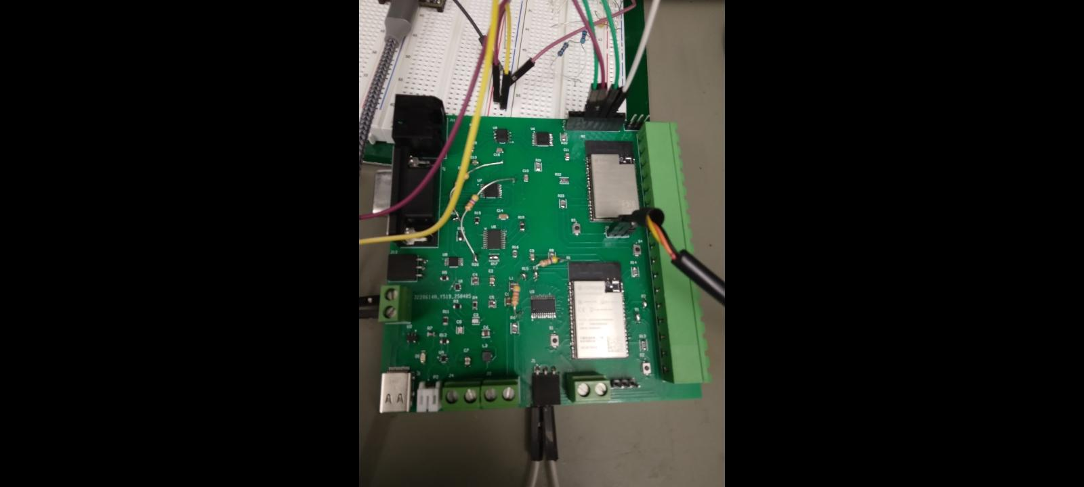
Integrated Project Board

Slide 4
Power and Data Processing Overview
Rohan Bharadwaj
Designed the portion of the electronic hardware that handled the power, battery fuel gauge levels, analog input signals, I2C signals, and 16 channel logic signals.
The design utilizes a Lithium-Ion battery, two voltage buck converters, a fuel gauge IC, a battery charging IC, an ADC converter, and an ESP32
Analog Signals
I2C Signals
3.3 V Buck Converter
ADC Converter
ESP32
3.7 V Li-Ion Battery
2.5 V Buck Converter
Fuel Gauge IC
16 bit GPIO Expander
Battery Charging IC
16 Channel Logic
Signals
USB

Slide 5
Power and Data Processing
Testing and Validation
Device | Expected Result | Measured Result | Result
3.3 V Buck Converter | 3.3 V | 3.29 V | Pass
2.5 V Buck Converter | 2.5 V | 2.5 V | Pass
ESP 32 | 3.3 V | 3.3 V | Pass
ADS1013 | 3.3 V | 3.3 V | Pass
BQ2750PW | 2.5 V | 2.5 V | Pass
MUX | 3.3 V | 3.3 V | Pass
MAX3232 | 3.3 V | 3.3 V | Pass
THVD1451 | 3.3 V | 3.3 V | Pass

Slide 6
Power and Data Processing Challenges and Solutions
Challenges | Solutions
Original ADC footprint was incorrect. FPGA was failing to be programmed correctly due to hardware and software configuration issues. ESP 32 does not have enough input pins to handle 16 channel logic. | ADC component was replaced and a brand new PCB was ordered. The design was updated to replace the FPGA with an additional ESP32 to handle the functionality that was originally intended for the FPGA. This change is reflected in the integrated PCB design Utilized a 16 bit GPIO expander that takes in the 16 channel logic signals and communicates to the ESP32 through I2C.

Slide 7
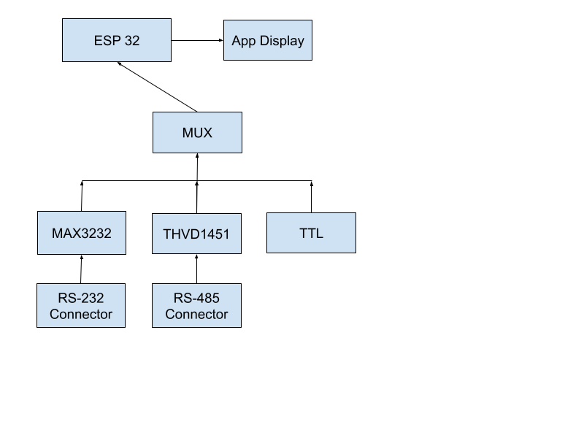
Data Collection and Communication Overview
Elijah Rodriguez
Designed a Serial Port sniffer that supports serial protocols RS-232, RS-485, and TTL. The RS protocols used voltage level converters that converted voltage levels to 3.3V so it satisfies the ESP32 operating voltage. A 4:1 MUX was used a to route the serial protocol signals to the ESP32 minimizing UART usage while expanding protocol support.

Slide 8
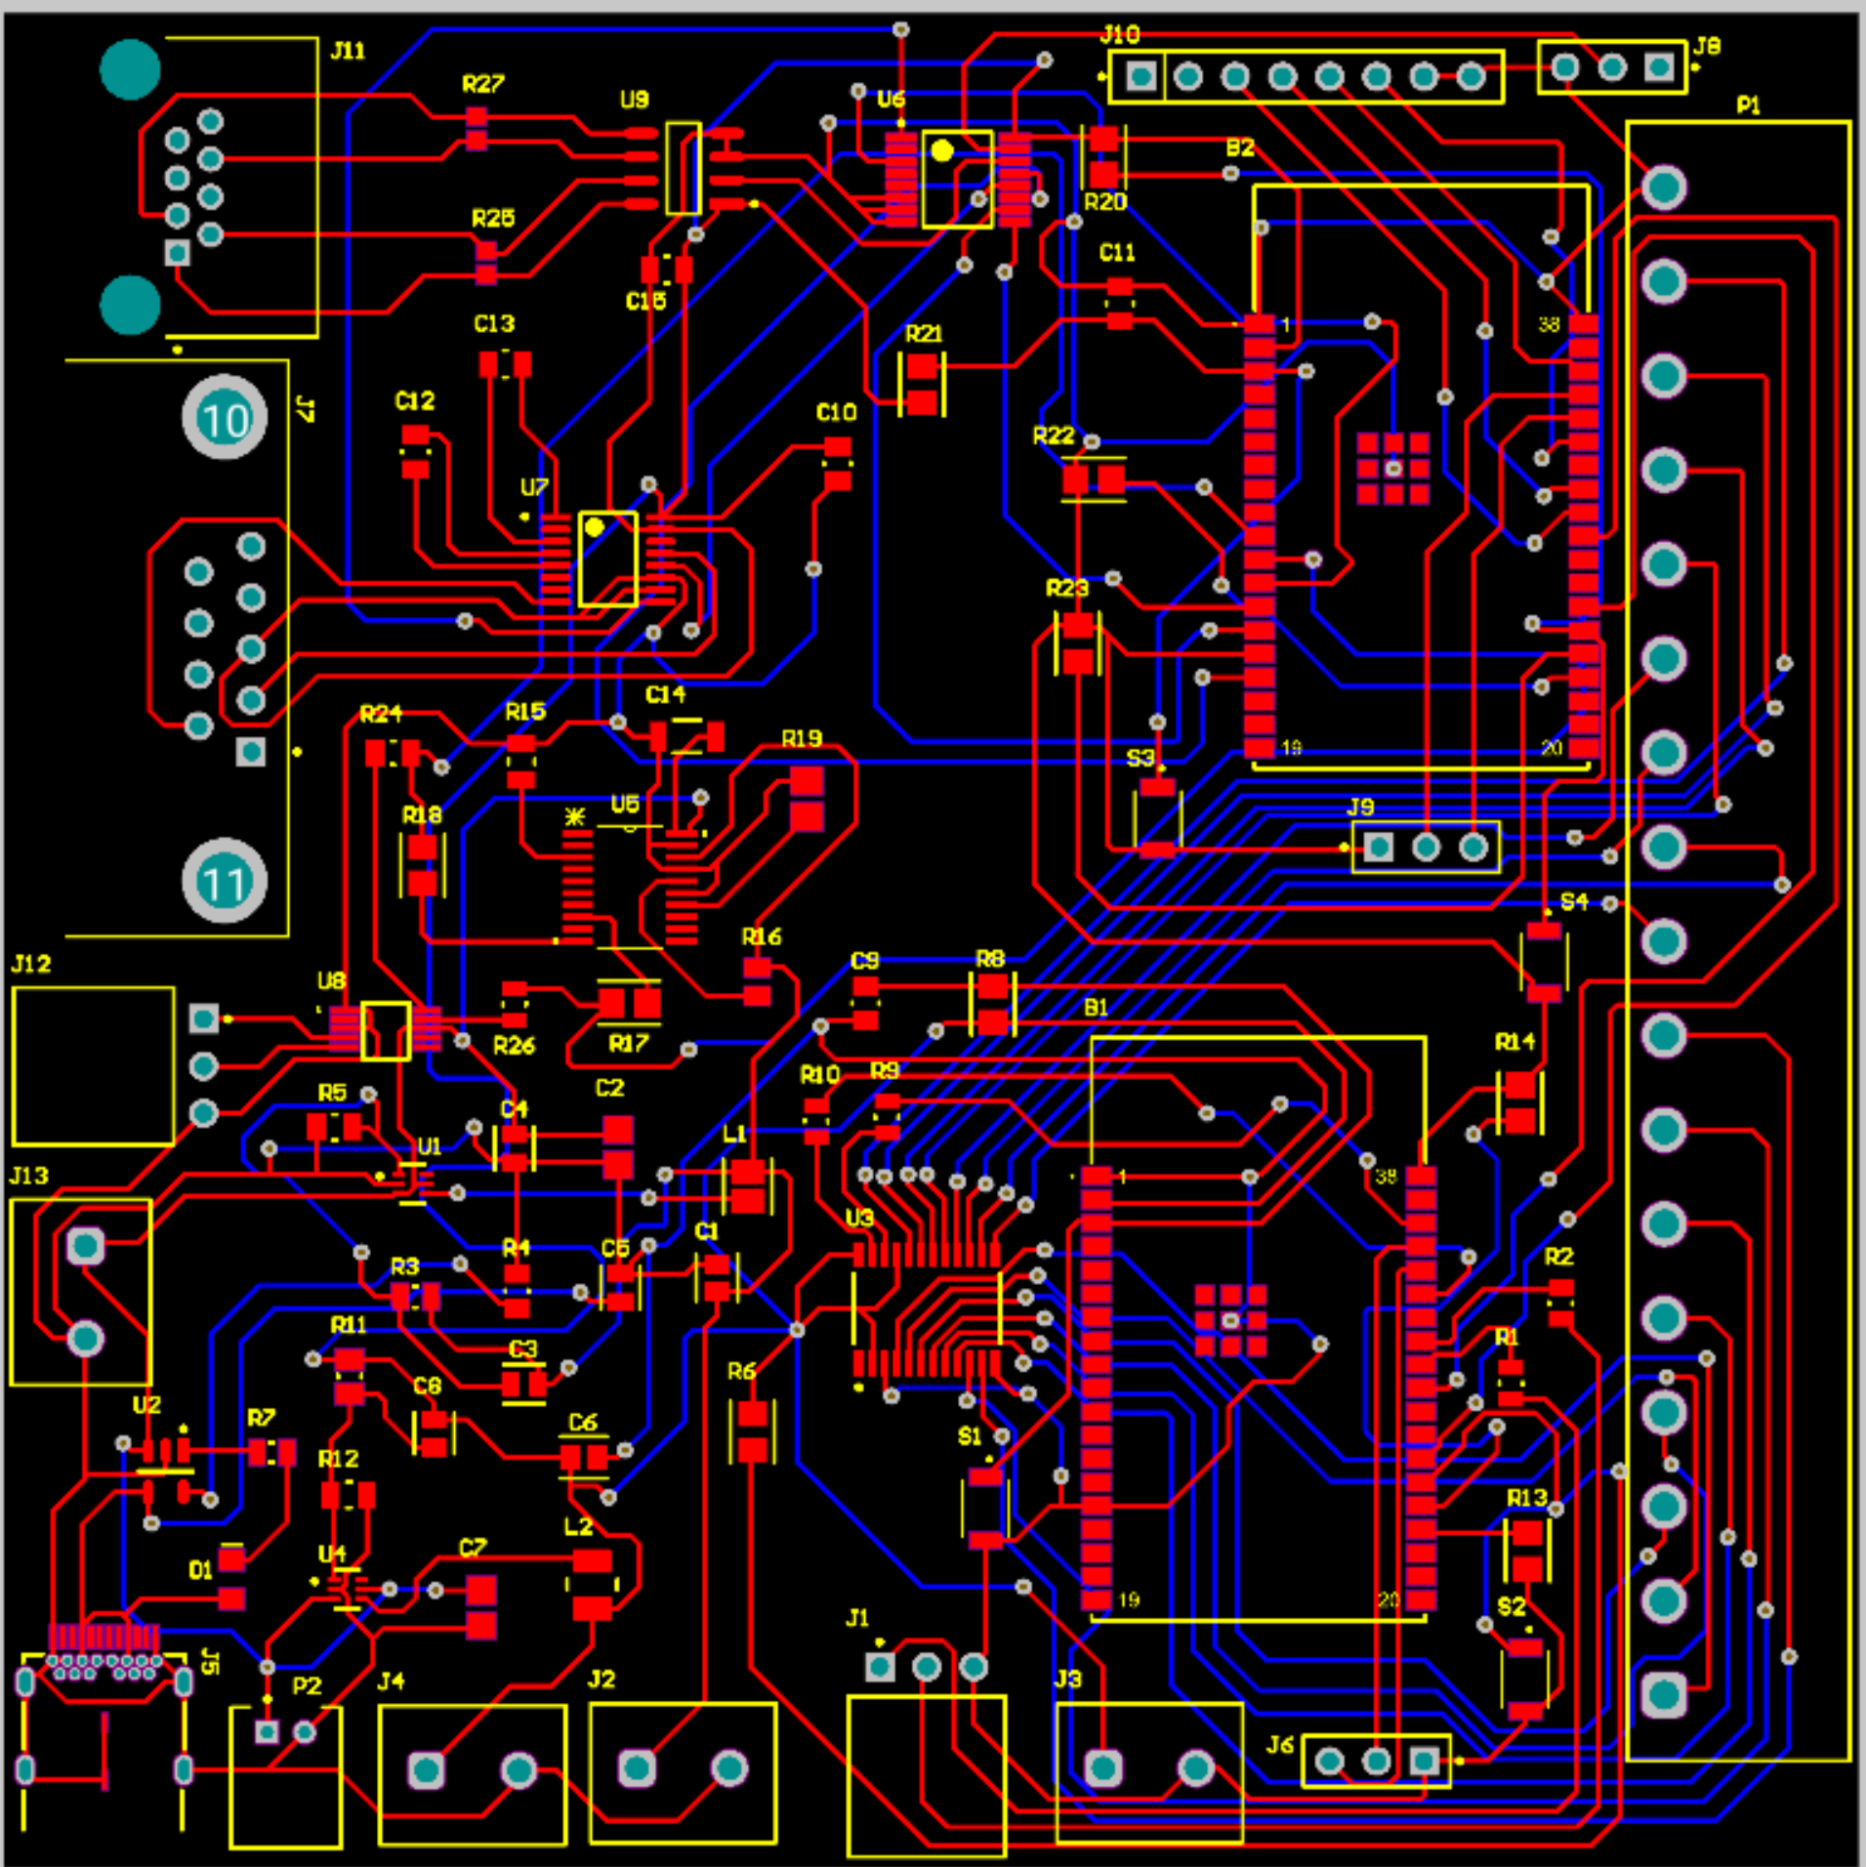
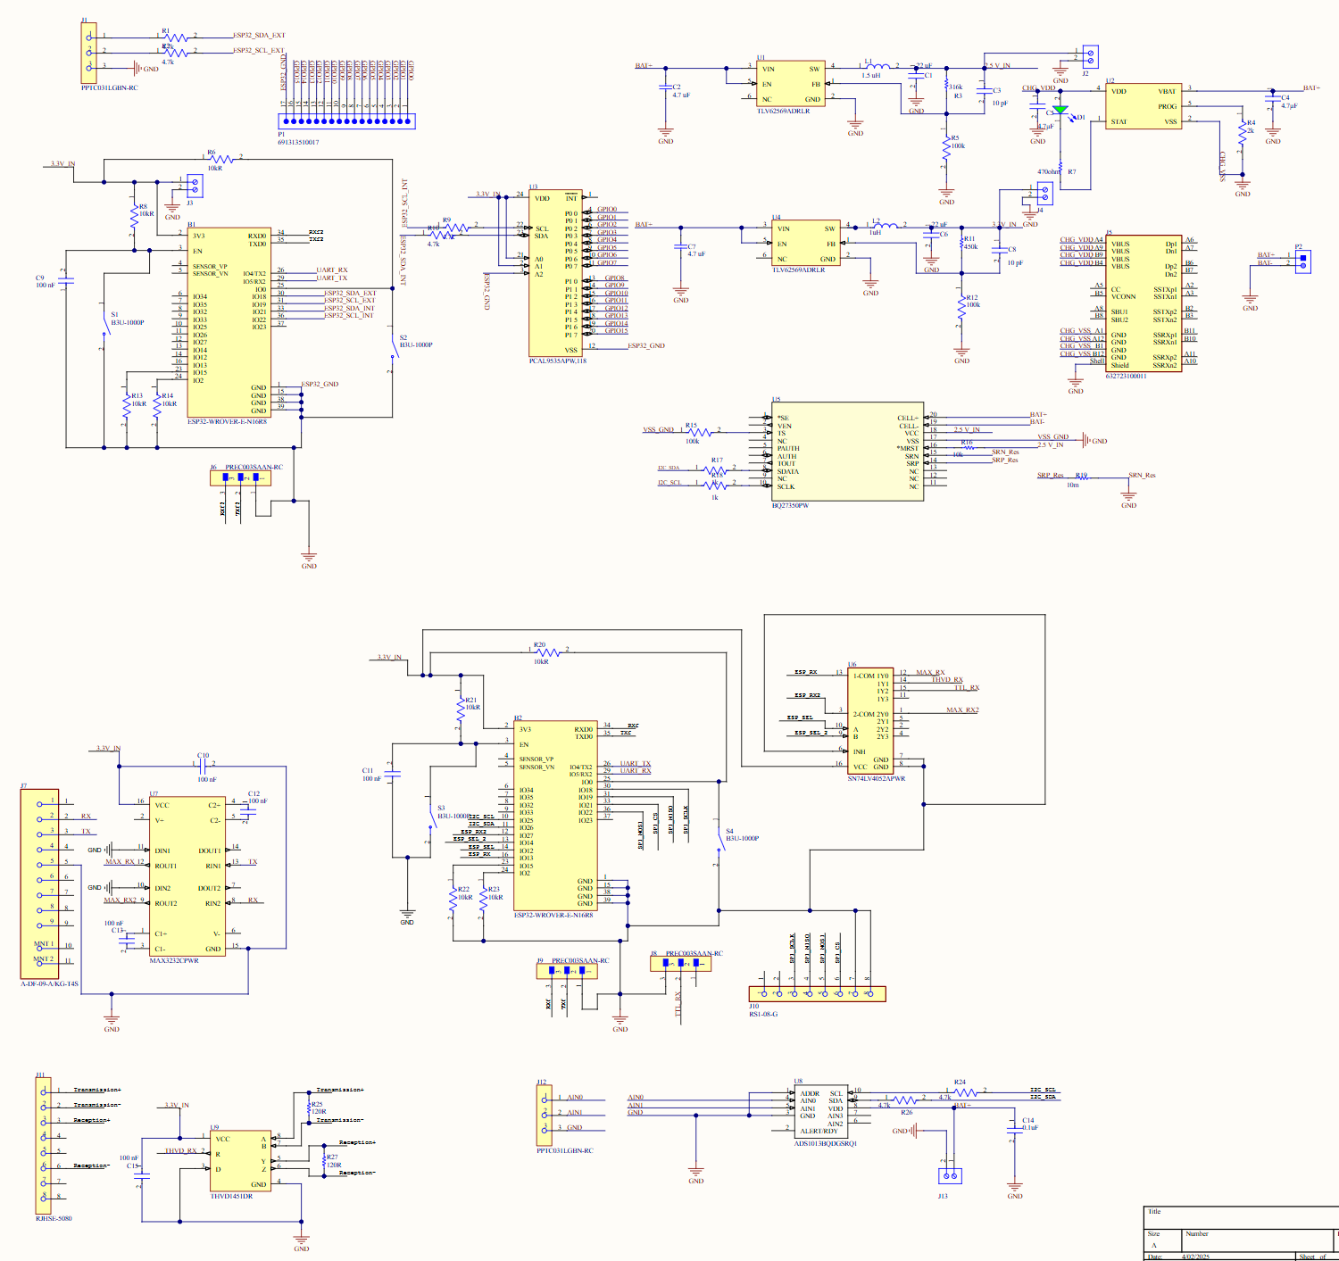
Data Collection and Communication
With the help of Rohan, we assembled and soldered all components which include connectors, voltage level converters, external connectors, and decoupling capacitors, etc for our integrated PCB.

Slide 9
Data Collection and Communication Testing and Validation
Test Criteria | Result
- All components on the PCB are being powered - All components output the proper voltage levels - MAX3232 and THVD1451 Level Shifting Verification - RealTerm Communication Validation | - PASS - PASS - PASS - RS-232 PASS

Slide 10
Data Collection and Communication Challenges and Solutions
Challenges | Solutions
- RS-485 Protocol Connection - Schematic and PCB errors before integrated board - Minor soldering errors that led to continuity issues | - Going to use a USB to RS-485 - Ordered new PCB with updated schematic - Used multimeter to find the continuity issues and resoldered where the errors were found

Slide 11
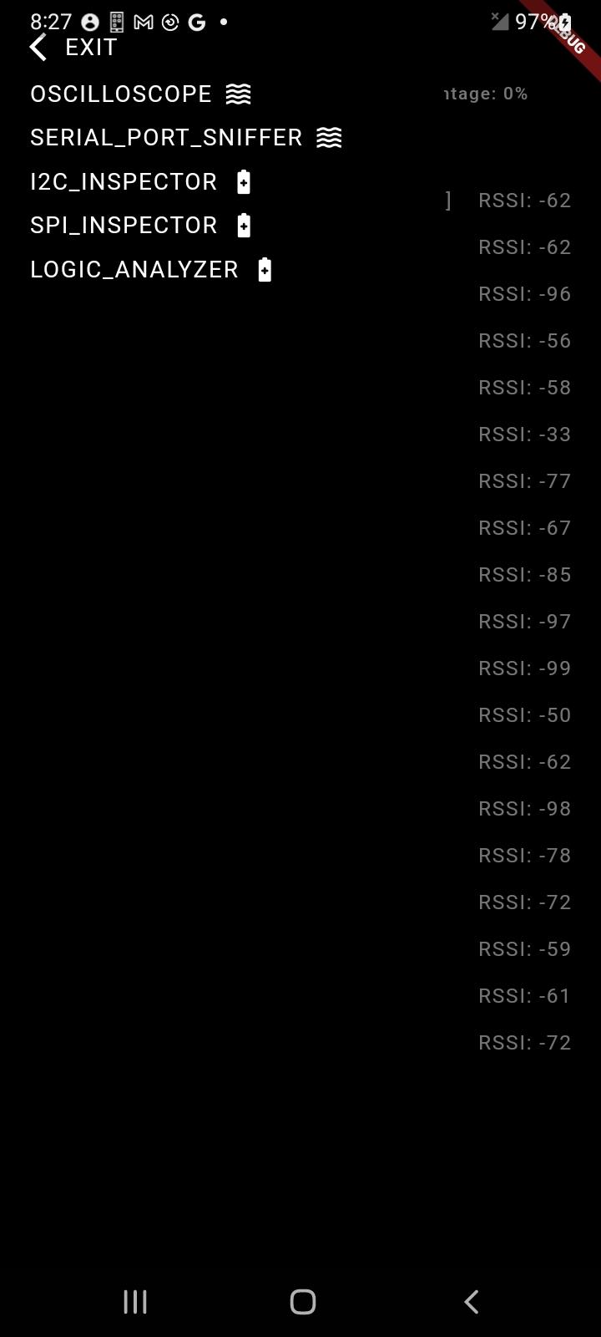
App Design Overview
Donavan Burrow
App designed to provide user with basic data information to use for troubleshooting purposes
Initial testing with ESP32 and App BLE showed good connectivity, however, problems with serial data transfer appeared with final board testing

Slide 12
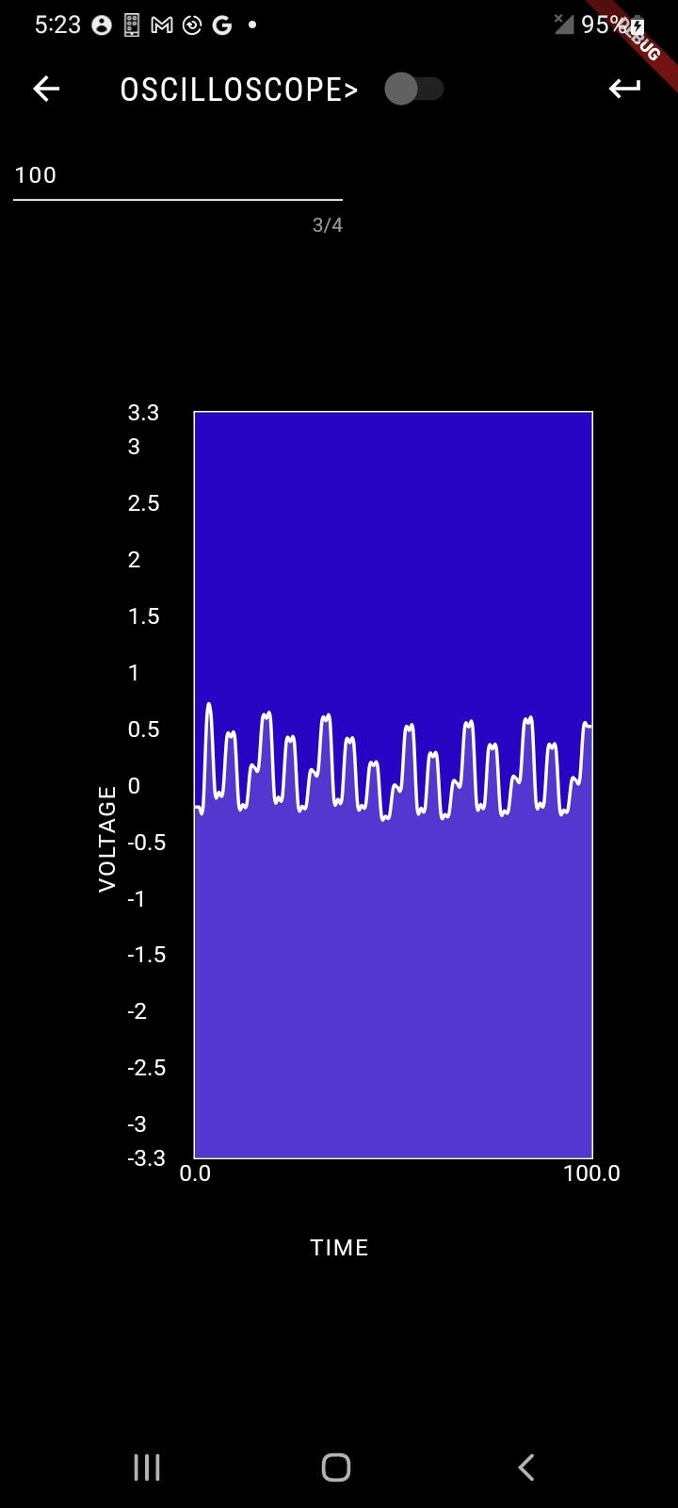
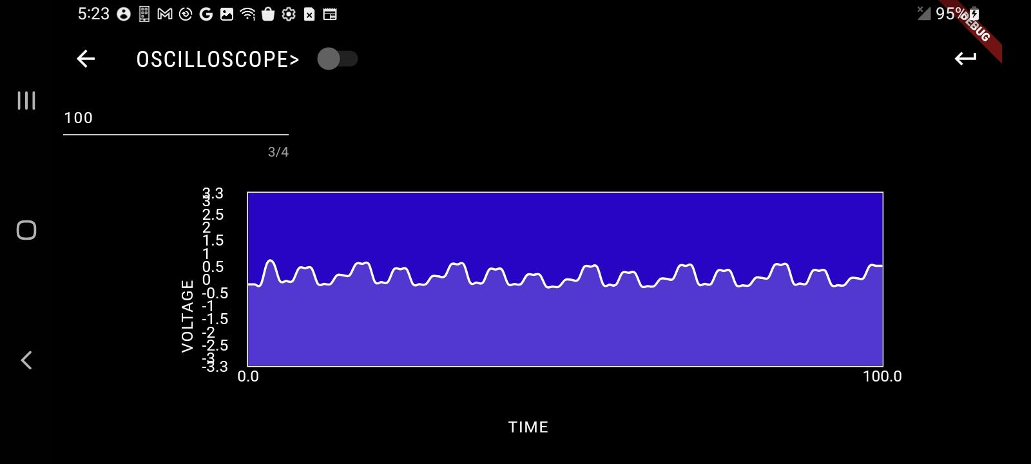
App Design
Data below collected by analyzing a 1kHz 0.5 amplitude sine wave, data collect is not perfect but is showing around expected range of voltages.

Slide 13
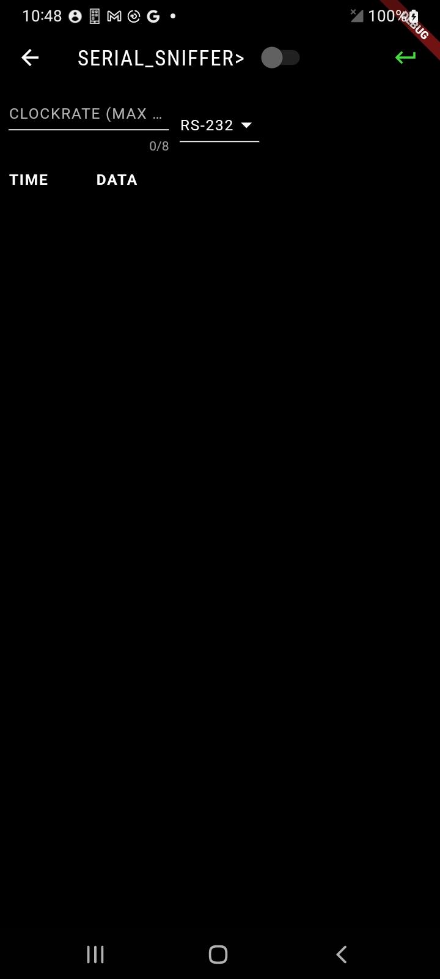
App Design

Slide 14
App Design
Testing and Validation
Test Criteria | Result
Connection event displayed on app Oscilloscope data received and displayed on app Logic analyzer data received and displayed on app Serial data received and displayed on app Battery indicator displays correct % to the user based on data collected from PCB | - PASS - PASS - NOT TESTED - FAILED/STILL TESTING - NOT TESTED

Slide 15
App Design
Challenges and Solutions
Challenges | Solutions
- Bluetooth data transfer for serial data types and real data - Accuracy of Oscilloscope Data | - Change handling for such cases on both firmware and app side to remove errors - Reimplement clock rate adjustment for user on the oscilloscope

Slide 16
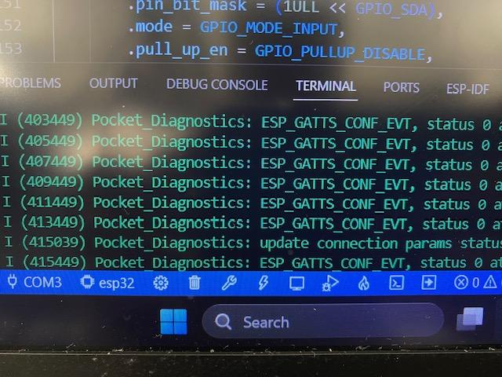
Firmware Design Overview
Jacob Newlin
Created firmware that gathered data via slave devices from two different ESP32s. Communicated data through bluetooth to the app via server-client BLE.
Initial integration with app passed all data types and functions, however after switching over from FPGA design to an ESP32 we have had issues with sending data from I2C, SPI and Serial to the App

Slide 17
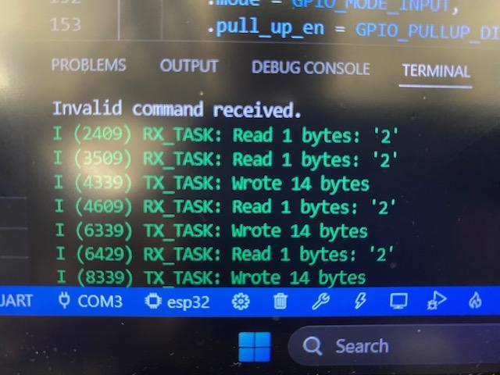
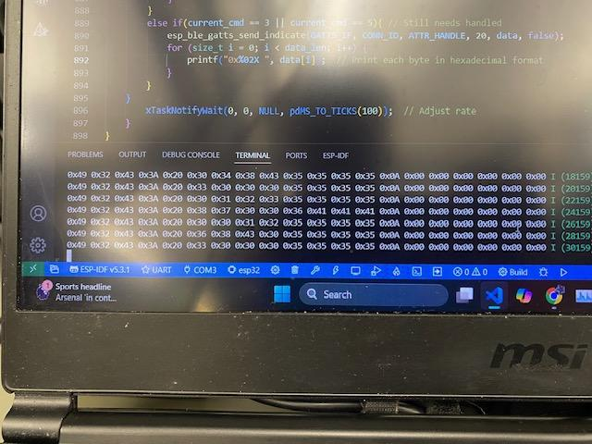
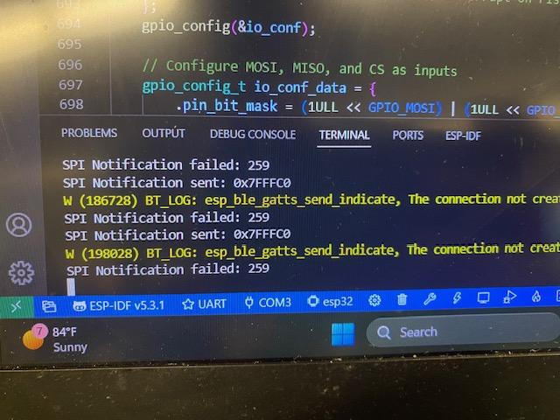
Firmware Design
Data grabbed from the SPI and I2C functions are shown below, with the RX and TX tasks being sent and received between the two ESP32s.

Slide 18
Firmware Design
Challenges and Solutions
Challenges | Solutions
- Distributing the workload of the FPGA between the two ESP32s - Handling freeRTOS applications along with BLE - Handling 7 different data functions - Communication issue with app regarding I2C and SPI data. | - Used a I/O extender, and case based coding to handle one at a time - Using interrupts and delays to minimize CPU usage -Troubleshooting and comparing to other operational functions

Slide 19
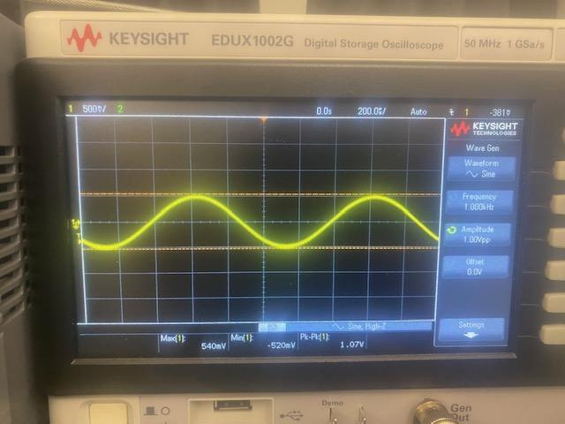
Integrated System Results

Slide 20
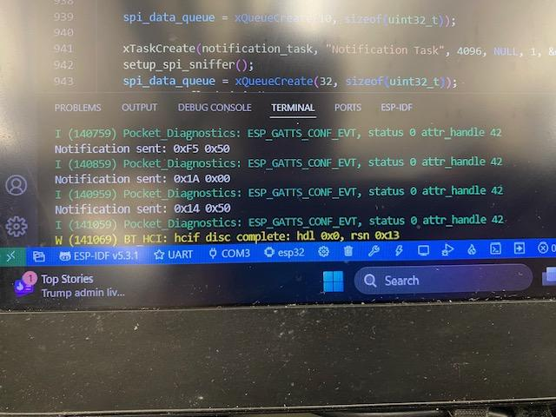
Integrated System Results

Slide 21
Integrated System Results

Slide 22
Conclusions
Issues
FPGA was failing to be programmed correctly due to hardware and software configuration issues. The design was updated to replace the FPGA with an additional ESP32 to handle the functionality that was originally intended for the FPGA.
Current status
Replacement PCB and BLE testing with real data

